Slide 1
CLASSIFICATION METHOD COMPARISON OF KNN AND SVM
Felisia (242859)
Nurul Gayatri Indah Reza (242861)

Slide 2
Contents
Research Plan
Motivation
Goal
Related works
Dataset
Methodology
KNN
SVM
Research environment
Measurement
KNN experiment group
SVM experiment group
KNN and SVM Comparison
Summary
2/67

Slide 3
Research Plan (Motivations and Goal)
Motivations
To know if simple algorithm is sufficient for classification.
To know the performance comparison between simple algorithm and complex algorithm in classification
Goal
To compare which algorithm ( between KNN and SVM) performs better for classification.
3/67

Slide 4
2. Related Works
Using KNN Algorithm for Text [1]
This study attempted to classify documents, based on the contents of the data, where the content is in textual type from 5,485 email documents. This study concludes that when the K value increases the classifier accuracy decreases, but for large k values it was found that the classifier accuracy was never below 55%.
4/67
Notes:
M. A. Wajeed and T. Adilakshmi. 2011. Using KNN algorithm for text categorization. In Vinu V. Das and Nessy Thankachan, editors, Computational Intelligence and Information Technology. Springer Berlin Heidelberg, Berlin, Heidelberg, pages 796–801.

Slide 5
Related works
Comparison of SVM and KNN to classify water quality status [2]
This study compare the accuracy of SVM and KNN by using testing with 10-fold Cross Validation. The highest result was achieved by SVM (92.40%) at linear kernel, while KNN is 71.28% (k=7)
5/67
Notes:
2. A. Danades, D. Pratama, D. Anggraini and D. Anggriani, "Comparison of accuracy level K-Nearest Neighbor algorithm and Support Vector Machine algorithm in classification water quality status," 2016 6th International Conference on System Engineering and Technology (ICSET), Bandung, 2016, pp. 137-141.

Slide 6
Related works
Automated Arabic Text Categorization Using SVM and NB [3]
In this article, the writer compare the performance of Naive Bayesian method (NB) and Support Vector Machine algorithm (SVM) for Arabic text classification.
The data set used for the experiment consist of 5121 Arabic documents of different lengths that belongs to 7 categories
The goal of this paper is to present and compare results obtained against Saudi Newspapers (SNP) Arabic text collections using Support Vector Machine (SVM) algorithm and Naïve Bayesian (NB) algorithm. The result of experiment is that, the SVM algorithm outperformed NB algorithm regards to F1, Recall and Precision measures.
6/67
Notes:
3 ?

Slide 7
3.Dataset
7/67

Slide 8
Dataset Origin
Source for dataset of heart existence:
https://www.kaggle.com/ronitf/heart-disease-uci
The data set contains numerical data type
Source for dataset of edible and poisonus mushroom:
The data set contains non numerical data type
https://www.kaggle.com/uciml/mushroom-classification
Dataset ratio for training : test= 80% : 20%
8/67

Slide 9
Dataset Description
Table 1.Dataset Description
Mushroom classification | Total data | 8,124
 | Number of attributes | 22
 | Training data | 6,499
 | Testing data | 1,625
 | Class | Edible(4,208), poisonous (3,916)
 | Range value | 0-12
Heart disease UCI | Total data | 303
 | Number of attributes | 14
 | Training data | 242
 | Testing data | 61
 | Class | Normal (138), abnormal (165)
 | Range value | 0-250
9/67
Notes:
[] https://www.kaggle.com/ronitf/heart-disease-uci
[] https://www.kaggle.com/uciml/mushroom-classification

Slide 10
Dataset for Mushroom Classification
Table 2. Mushroom dataset sample
class | cap-shape | cap-surface | cap-color | bruises | odor | gill-attachment | gill-spacing | gill-size | gill-color | stalk-shape
p | x | s | n | t | p | f | c | n | k | e
e | x | s | y | t | a | f | c | b | k | e
e | b | s | w | t | l | f | c | b | n | e
stalk-root | stalk-surface-above-ring | stalk-surface-below-ring | stalk-color-above-ring | stalk-color-below-ring | veil-type | veil-color | ring-number | ring-type | spore-print-color | population | habitat
e | s | s | w | w | p | w | o | p | k | s | u
c | s | s | w | w | p | w | o | p | n | n | g
c | s | s | w | w | p | w | o | p | n | n | m
10/67
Notes:
1. cap-shape: bell=b,conical=c,convex=x,flat=f, knobbed=k,sunken=s 2. cap-surface: fibrous=f,grooves=g,scaly=y,smooth=s 3. cap-color: brown=n,buff=b,cinnamon=c,gray=g,green=r, pink=p,purple=u,red=e,white=w,yellow=y 4. bruises?: bruises=t,no=f 5. odor: almond=a,anise=l,creosote=c,fishy=y,foul=f, musty=m,none=n,pungent=p,spicy=s 6. gill-attachment: attached=a,descending=d,free=f,notched=n 7. gill-spacing: close=c,crowded=w,distant=d 8. gill-size: broad=b,narrow=n 9. gill-color: black=k,brown=n,buff=b,chocolate=h,gray=g, green=r,orange=o,pink=p,purple=u,red=e, white=w,yellow=y 10. stalk-shape: enlarging=e,tapering=t 11. stalk-root: bulbous=b,club=c,cup=u,equal=e, rhizomorphs=z,rooted=r,missing=? 12. stalk-surface-above-ring: fibrous=f,scaly=y,silky=k,smooth=s 13. stalk-surface-below-ring: fibrous=f,scaly=y,silky=k,smooth=s 14. stalk-color-above-ring: brown=n,buff=b,cinnamon=c,gray=g,orange=o, pink=p,red=e,white=w,yellow=y 15. stalk-color-below-ring: brown=n,buff=b,cinnamon=c,gray=g,orange=o, pink=p,red=e,white=w,yellow=y 16. veil-type: partial=p,universal=u 17. veil-color: brown=n,orange=o,white=w,yellow=y 18. ring-number: none=n,one=o,two=t 19. ring-type: cobwebby=c,evanescent=e,flaring=f,large=l, none=n,pendant=p,sheathing=s,zone=z 20. spore-print-color: black=k,brown=n,buff=b,chocolate=h,green=r, orange=o,purple=u,white=w,yellow=y 21. population: abundant=a,clustered=c,numerous=n, scattered=s,several=v,solitary=y 22. habitat: grasses=g,leaves=l,meadows=m,paths=p, urban=u,waste=w,woods=d

Slide 11
Preprocessing Dataset Mushroom
Transforming non-numerical data values into numerical values
LabelEncoder library is used in this preprocessing.
The library will change the distinct data values into a numerical data
Example 1: Male=0, Female=1
Example2 : Red=0, Yellow=1, Green=2
11/67

Slide 12
Dataset Heart Disease UCI
Table 3. Heart disease dataset sample
age | sex | cp | trestbps | chol | fbs | restecg | thalach | exang | oldpeak | slope | ca | thal | target
63 | 1 | 3 | 145 | 233 | 1 | 0 | 150 | 0 | 2.3 | 0 | 0 | 1 | 1
37 | 1 | 2 | 130 | 250 | 0 | 1 | 187 | 0 | 3.5 | 0 | 0 | 2 | 1
41 | 0 | 1 | 130 | 204 | 0 | 0 | 172 | 0 | 1.4 | 2 | 0 | 2 | 1
1. age
2. sex
3. chest pain type (4 values)
4. resting blood pressure
5. serum cholestoral in mg/dl
6. fasting blood sugar 120 mg/dl
7. resting electrocardiographic results (values 0,1,2)
8. maximum heart rate achieved
9. exercise induced angina
10. oldpeak = ST depression induced by exercise relative to rest
11. the slope of the peak exercise ST segment
12. number of major vessels (0-3) colored by flourosopy
13. thal: 3 = normal; 6 = fixed defect; 7 = reversable defect
12/67

Slide 13
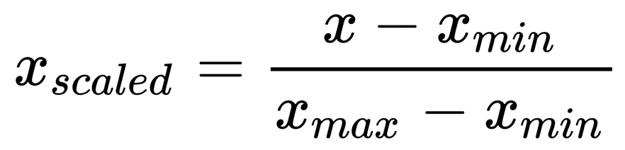
Dataset Preprocessing for Heart Disease KNN
Normalization
Standard Scaler [4]
z = (x - u) / s
distribution is centered around 0 (mean), with a standard deviation of 1.
Minmax Normalization
The values range between 0 to 1
Fig 1. Formula of minmax normalization source: https://learning.oreilly.com/library/view/regression-analysis-with/9781788627306/6bb0d820-6200-4bfe-aa91-e7b7ffa2a9c1.xhtml
13/67
Notes:
[4] https://scikit-learn.org/stable/modules/generated/sklearn.preprocessing.StandardScaler.html#sklearn.preprocessing.StandardScaler
[] https://learning.oreilly.com/library/view/regression-analysis-with/9781788627306/6bb0d820-6200-4bfe-aa91-e7b7ffa2a9c1.xhtml
where u is the mean of the training samples, and s is the standard deviation of the training samples
The range is the difference between the original maximum and original minimum

Slide 14
4. Methodology
14/67

Slide 15
KNN
The K-Nearest Neighbor (KNN) is one of the simplest lazy machine learning algorithms.
Algorithm objective is to classify objects into one of the predefined classes of a sample group.
The training data is used during the testing phase.
KNN is based on finding the most similar objects (documents) from sample groups based on some distance or similarity measurement[5][6].
15/67
Notes:
5. Bruno Trstenjak, Sasa Mikac, and Dzenana Donko. 2014. Knn with tf-idf based framework for text categorization. In Procedia Engineering. volume 69, pages 1356–1364.
6. Korde, Vandana. (2012). Text Classification and Classifiers:A Survey. International Journal of Artificial Intelligence & Applications. 3. 85-99. 10.5121/ijaia.2012.3208.

Slide 16
SVM
SVM is a linear learning method that finds an optimal hyperplane to separate two classes [7]. It has a solid theoretical foundation and its classification performance is more accurate than most other algorithms in many applications.
Support Vector Machine (SVM) was first introduced by Boser, Guyon, and Vapnik in COLT-92 [8].
16/67

Slide 17
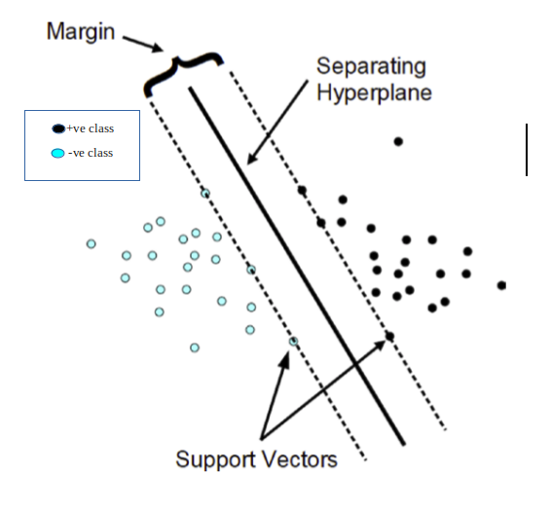
SVM
Support Vectors: data points closest to the hyperplane.
Hyperplane: separates objects from different classes.
Margin: a gap between the two lines
Fig 2. Diagrammatic representation of SVM for linearly separable dataset (Source: https://www.researchgate.net/figure/Classification-of-data-by-support-vector-machine-SVM_fig8_304611323)
17/67
Notes:
Support Vectors: data points closest to the hyperplane. It will define the separating line by calculating margin. This points more relevant for building the classifier.
Hyperplane: separates objects from different classes.
Margin: a gap between the two lines on the closest class points (support vectors). The larger the margin the better it is. This gives you a classification safety margin: a slight error in measurement or a slight document variation will not cause a misclassification

Slide 18
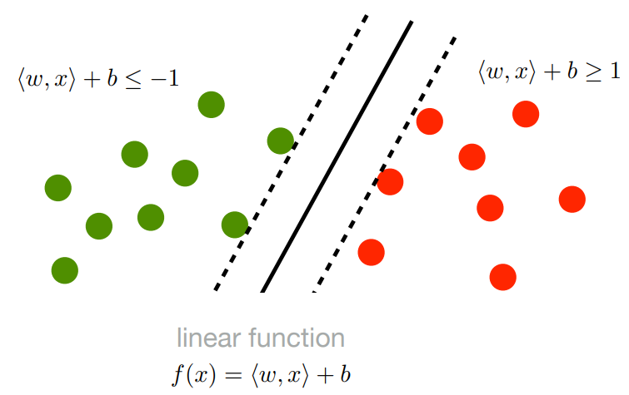
Hyperplane equation in SVM
The hyperplane represented by f(x)=0
F(x)=0 => (w.x) + b = 0
Wi = vectors(W0,W1,W2,… Wm)
b = biased term (W0)
X = variables.
Fig 3. Diagram of Hard Margin SVM [9]
18/67
Notes:
Support Vectors: data points closest to the hyperplane. It will define the separating line by calculating margin. This points more relevant for building the classifier.
Hyperplane: separates objects from different classes.
Margin: a gap between the two lines on the closest class points (support vectors). The larger the margin the better it is. This gives you a classification safety margin: a slight error in measurement or a slight document variation will not cause a misclassification
[8.9]

Slide 19
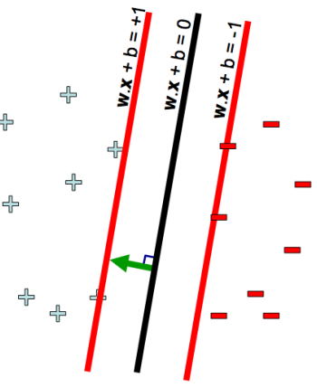
Hyperplane equation in SVM
The hyperplane represented by f(x)=0
F(x) = 0 => (w.x) + b = 0
f(x) = 0 => hyperplane
f(x)= -1 => negative class
If f(x) < -1 then x belong to negative class
f(x)= +1 => positive class
If f(x) > +1 then x belong to positive class
Fig 4. Diagram of Scale invariance in SVM [9]
19/67
Notes:
[9] Erdem, Aykut. 2017. Lecture 15: −Support Vector Machines −Soft Margin Classification. https://web.cs.hacettepe.edu.tr/~aykut/classes/fall2017/bbm406/slides/l15-support_vector_machines.pdf

Slide 20


Hard Margin vs Soft Margin
SVM with slack variables allows samples to fall within the margin, but penalizes them.
Hard Margin formula to maximize the margin
Soft Margin formula with slack variables. C = tradeoff parameter tradeoff between the error and the margin, to control the overfitting.
Fig 5.Hard margin formula explaination [10]
Fig 6. Soft margin formula explaination [10]
20/67
Notes:
[10] https://www.cs.umd.edu/~samir/498/SVM.pdf?fbclid=IwAR1txSdO3y1XJUXrBSPQUKJezNWE6aMfena-EvR6H1dCx2WeNrEpfEpVr64

Slide 21


Large Margin,Cost Function, and Gradient
Hinge loss function help to maximise margin in SVM
Gradient obtained from partial derivative of loss function can be used to update weight
If misclassification= none then update gradient from regularization parameter
If misclassification<> none then update gradient from regularization parameter including the loss
Fig 7. Formula to update gradient (no misclassification)
Fig 8. Formula to update gradient (there is occur misclassification)
Source: https://towardsdatascience.com/support-vector-machine-introduction-to-machine-learning-algorithms-934a444fca47
21/67

Slide 22
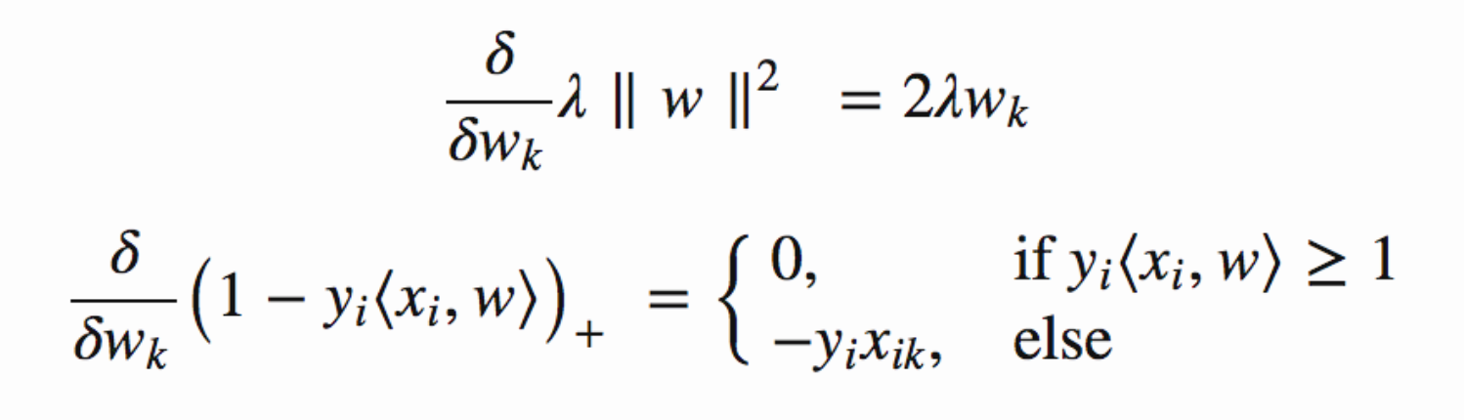
Large Margin,Cost Function, and Gradient
α(0.0001) is the learning rate and the regularization parameter λ is set to 1/epochs.[11]
How many times gradient updated depends on the maximum epochs.
Fig 9. Gradient formula
Source: https://towardsdatascience.com/support-vector-machine-introduction-to-machine-learning-algorithms-934a444fca47
22/67
Notes:
[11] ? gandhi 2018

Slide 23
5. Research environment
Link to the project is https://github.com/ryukya/AI_2020
23/67

Slide 24
Research Environment
Languages used: Python 2,Python 3
Libraries used:Pandas, Csv, Linalg, Scaler, numpy,LabelEncoder,train test split, classification report, confusion matrix, accuracy score, random.
Software used: Jupyter Notebook, Google Collabs
SVM Implementation based on https://towardsdatascience.com/support-vector-machine-introduction-to-machine-learning-algorithms-934a444fca47
24/67

Slide 25
6. Measurement
25/67

Slide 26
Measurement [12]
Recall
Out of all the positive classes, how much we predicted correctly. It should be high as possible.
Precision
Out of all the positive classes we have predicted correctly, how many are actually positive.
Accuracy
Out of all the classes, how much we predicted correctly. It should be as high as possible.
F-Score
F-score helps to measure Recall and Precision at the same time.
26/67
Notes:
[12] Sarang Narkhede. 2018. Blog: https://towardsdatascience.com/understanding-confusion-matrix-a9ad42dcfd62

Slide 27
7. KNN experiment group
27/67

Slide 28
Experiment 1. Analysis of KNN between 2 different dataset (non-numerical and numerical)
Goal : non-numerical and numerical dataset may have a different effect in knn algorithm, this experiment aims to find the difference in accuracy between dataset
Assumption
Constant : mushroom and heart disease dataset
Tested value : number of k neighbour (5,6,10,20,30,40)
28/67

Slide 29
Experiment 1.
Course of experiment
KNN classification is applied to both dataset.
Find distance from testing data to training data
Set k value, and vote for the most frequent class from training data based on the distance.
Result (Table 2)
Mushroom dataset
Highest accuracy (k=5,6,10) = 100%
Average accuracy = 99.28%
Heart disease dataset
Highest accuracy (k=6) = 73.7%
Average accuracy = 66.9%
29/67
Notes:
For mushroom dataset the highest accuracy of 100% is in k=5,6 and 10, while in heart disease the highest is in 6 with 73.7%. The average accuracy for mushroom dataset is 98.4% while heart disease is 66.9%

Slide 30
Experiment 1. Result
Table 4. Comparison of measurement between 2 dataset
k | mushroom |  |  |  | heart disease normal
 | accuracy | precision | recall | f-score | accuracy | precision | recall | f-score
5 | 100.00% | 100.00% | 100.00% | 100.00% | 59.02% | 61.00% | 61.00% | 59.00%
6 | 100.00% | 100.00% | 100.00% | 100.00% | 73.77% | 73.00% | 73.00% | 73.00%
10 | 100.00% | 100.00% | 100.00% | 100.00% | 67.21% | 67.00% | 67.00% | 67.00%
20 | 98.58% | 99.00% | 99.00% | 99.00% | 70.49% | 71.00% | 71.00% | 70.00%
30 | 97.78% | 99.00% | 99.00% | 99.00% | 65.57% | 66.00% | 67.00% | 66.00%
40 | 95.08% | 98.00% | 98.00% | 98.00% | 65.57% | 69.00% | 68.00% | 65.00%
30/67

Slide 31
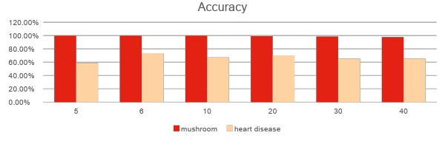
Experiment 1. Result
Table 5. Comparison of accuracy between 2 dataset
k | mushroom | heart disease
5 | 100.00% | 59.02%
6 | 100.00% | 73.77%
10 | 100.00% | 67.21%
20 | 99.32% | 70.49%
30 | 98.58% | 65.57%
40 | 97.78% | 65.57%
avg | 99.28% | 66.94%
Fig 10. Accuracy of KNN between 2 dataset
31/67

Slide 32
Experiment 1. Comment
After replacing non-numerical into numerical data, non-numerical has a better accuracy than numerical data.
But the range of minimum and maximum data is small in mushroom dataset (0-10) compared to heart disease (0-250).
KNN is based on distance, data range affects the classification.
32/67

Slide 33
Experiment 2. Analysis of data normalization in KNN for Heart Disease dataset using Feature Scaling
Goal : KNN is based on distance, thus different type of Feature scaling which reduce the range in dataset may affect the accuracy of KNN algorithm. Therefore this experiment is to find the accuracy after using feature scaling/data normalization
Assumption
Constant : number of k neighbour (5,6,10,20,30,40)
Tested value : normal heart disease dataset, dataset after feature scaling with StandardScaler and Minmax normalization
33/67

Slide 34
Experiment 2.
Course of experiment
Heart disease dataset is normalized with standardscaler and minmax normalization using python library.
Find the distance between normal testing data with training data, testing and training after standardscaler and minmax normalization.
Find predicted class by voting for the most frequent class from training data based on the distance.
Result
Standardscaler
Highest accuracy (k=6) = 78.69%, average = 76.50%
Minmax normalization
Average accuracy (k=6) = 85.25%, average 79.51%
34/67
Notes:
The accuracy for heart disease dataset increased after normalizing dataset range. With standardscaler, the highest accuracy was 78.69% while in minmax was 85.25%. And the average is 76.50% for standardscaler and 79.51% for minmax.
14.29% 18.78%

Slide 35
Experiment 2. Result
Table 6. Comparison of measurement after feature scaling
 | heart disease normal |  |  |  | heart disease scaler |  |  |  | heart disease minmax
k | accuracy | precision | recall | f-score | accuracy | precision | recall | f-score | accuracy | precision | recall | f-score
5 | 0.59 | 0.61 | 0.61 | 0.59 | 0.75 | 0.77 | 0.77 | 0.75 | 0.82 | 0.82 | 0.83 | 0.82
6 | 0.74 | 0.73 | 0.73 | 0.73 | 0.79 | 0.79 | 0.80 | 0.79 | 0.85 | 0.85 | 0.85 | 0.85
10 | 0.67 | 0.67 | 0.67 | 0.67 | 0.77 | 0.77 | 0.78 | 0.77 | 0.79 | 0.78 | 0.79 | 0.78
20 | 0.70 | 0.71 | 0.71 | 0.70 | 0.77 | 0.79 | 0.79 | 0.77 | 0.79 | 0.79 | 0.80 | 0.79
30 | 0.66 | 0.66 | 0.67 | 0.66 | 0.75 | 0.78 | 0.78 | 0.75 | 0.77 | 0.78 | 0.79 | 0.77
40 | 0.66 | 0.69 | 0.68 | 0.65 | 0.75 | 0.78 | 0.78 | 0.75 | 0.75 | 0.77 | 0.77 | 0.75
35/67

Slide 36
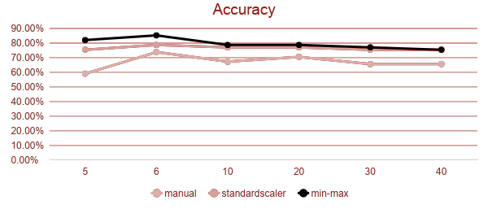
Experiment 2. Result
Table 7. Comparison of accuracy on feature scaling
k | manual | standardscaler | min-max
5 | 59.02% | 75.41% | 81.97%
6 | 73.77% | 78.69% | 85.25%
10 | 67.21% | 77.05% | 78.69%
20 | 70.49% | 77.05% | 78.69%
30 | 65.57% | 75.41% | 77.05%
40 | 65.57% | 75.41% | 75.41%
avg | 66.94% | 76.50% | 79.51%
Fig 11. Accuracy chart for normal and after feature scaling
36/67

Slide 37
Experiment 2. Comment
KNN is based on distance measurement.
The range between data affect the accuracy of KNN
Feature Scaling or data normalization increase the accuracy of data
Standardscaler increased the accuracy by 14.29%
Minmax normalization increased the accuracy by 18.78%
37/67
Notes:
14.29% 18.78%

Slide 38
8. SVM experiment group
38/67

Slide 39
Experiment 3. Analysis of SVM performance between 2 different dataset (non-numerical and numerical)
Goal :
Numerical data and non numerical data has different approach in values. This experiment is made to know if there is any performance difference of SVM for different data type
39/67

Slide 40
Experiment 3. Analysis of SVM performance between 2 different dataset (non-numerical and numerical)
Assumption
Table 8. Constant and tested value of Experiment 3
Constant | Tested value
epoch=500 - alpha=0.002 epoch=1000 - alpha=0.001 epoch=2000 alpha=0.0005 Epoch in this table is the maximum epoch (which will be used in the iteration in SVM) | Mushroom dataset (non numerical type)
Number of data =303
Number of features=13 | Hear diseases dataset (numerical type)
Both are single class classification (1 or 0)
40/67

Slide 41
Experiment 3. Analysis of SVM performance between 2 different dataset (non-numerical and numerical)
Course of experiment:
Load Mushroom and heart disease dataset
Mushroom data are transformed to numerical value. The number of data and feature are reduced as per the constant parameter in assumption
SVM Classification is applied to both dataset.
Measure the performance using sklearn.metrics
41/67

Slide 42
Experiment 3. Analysis of SVM performance between 2 different dataset (non-numerical and numerical)
Table 9.. SVM Comparison of measurement on 2 different dataset
 |  | Mushroom data |  |  |  | Heart Diseases Data
epoch | Alpha | Accuracy | Precision | Recall | F1 | Accuracy | Precision | Recall | F1
500 | 0.002 | 0.46 | 0.72 | 0.54 | 0.38 | 0.57 | 0.75 | 0.63 | 0.54
1000 | 0.005 | 0.9 | 0.91 | 0.89 | 0.9 | 0.61 | 0.76 | 0.66 | 0.58
2000 | 0.0001 | 0.9 | 0.9 | 0.91 | 0.9 | 0.62 | 0.77 | 0.67 | 0.6
Average |  | 0.75 | 0.84 | 0.78 | 0.73 | 0.6 | 0.76 | 0.65 | 0.57
42/67

Slide 43
Experiment 3. Analysis of SVM performance between 2 different dataset (non-numerical and numerical)
Result:
Mushroom dataset
Highest accuracy (epoch=1000, epoch =2000) = 90%
Average accuracy = 75%
Heart disease dataset
Highest accuracy (epoch=2000) = 62%
Average accuracy = 60%
Comment:
Mushroom dataset has a higher accuracy then heart diseases. So it can be concluded that SVM works better in non numerical data.
43/67

Slide 44
Experiment 4. Analysis of impact of alpha and epoch variances to SVM performance
Goal :
In SVM searching optimum weight to obtain large margin can be done by updating the gradient until a good accuracy can be obtained. Alpha (learning rate) an epoch (in lambda) is used to update the gradient and obtain the w value. This experiment is done to analyse whether there is an impact of alpha and epoch variances to SVM accuracy in numerical and non numerical data
44/67

Slide 45
Experiment 4. Analysis of impact of alpha and epoch variances to SVM performance
Assumption
Table 10. Constant and tested value of Experiment 4
Constant | Tested value
epoch=500 - alpha=0.002 epoch=1000 - alpha=0.001 epoch=2000 alpha=0.0005 epoch=5000 - alpha=0.0002 epoch=10000 alpha=0.0001 Epoch in this table is the maximum epoch (which will be used in the iteration in SVM) | Mushroom dataset (non numerical type)
Both are single class classification (1 or 0) | Hear diseases dataset (numerical type)
45/67

Slide 46
Experiment 4. Analysis of impact of alpha and epoch variances to SVM performance
Course of experiment:
Load mushroom and heart diseases dataset
Mushroom data are transformed to numerical value.
Apply SVM Classification is applied to both dataset for 5 pairs of alpha and epoch
Measure the performance using sklearn.metrics
Result:
Mushroom dataset
Highest accuracy (epoch=10000) = 96%
Average accuracy = 78%
Heart disease dataset
Highest accuracy (epoch=10000) = 75%
Average accuracy = 64%
46/67

Slide 47
Experiment 4. Analysis of impact of alpha and epoch variances to SVM performance
Table 11. SVM Comparison of measurement for different alpha and epoch
 |  | Mushroom data |  |  |  | Heart Diseases Data
epoch | Alpha | Accuracy | Precision | Recall | F1 | Accuracy | Precision | Recall | F1
500 | 0.002 | 0.7 | 0.73 | 0.71 | 0.7 | 0.57 | 0.75 | 0.63 | 0.54
1000 | 0.005 | 0.53 | 0.77 | 0.5 | 0.35 | 0.61 | 0.76 | 0.66 | 0.58
2000 | 0.0001 | 0.82 | 0.84 | 0.83 | 0.82 | 0.62 | 0.77 | 0.67 | 0.6
5000 | 0.0002 | 0.91 | 0.92 | 0.91 | 0.91 | 0.66 | 0.78 | 0.7 | 0.64
10000 | 0.0001 | 0.96 | 0.96 | 0.96 | 0.96 | 0.75 | 0.78 | 0.78 | 0.75
Average |  | 0.784 | 0.844 | 0.782 | 0.748 | 0.642 | 0.768 | 0.688 | 0.622
47/67

Slide 48
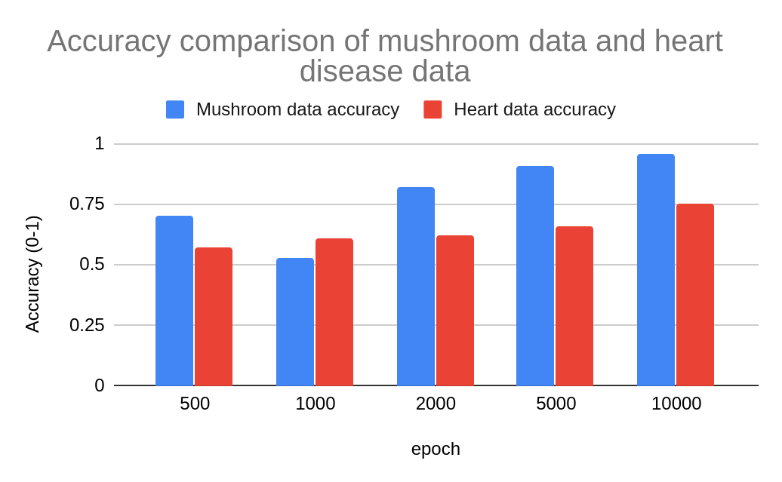
Experiment 4. Analysis of impact of alpha and epoch variances to SVM performance
Fig 12. Accuracy comparison chart
48/67

Slide 49
Experiment 4. Analysis of impact of alpha and epoch variances to SVM performance
Comment:
High alpha and epoch increase the performance of SVM.
Lower value of alpha and epoch tend to produce lower accuracy.
The difference in the accuracy value jump between Mushroom and Heart dataset might be caused of the difference in the data type. Since based on experiment 3, non numerical data has better performance dan numerical data.
49/67

Slide 50
Experiment 5. Analysis of impact dataset features reduction to SVM performance
Goal :
Number of features in dataset determine the dimension of the plane. This experiment is made to analyse the impact of features reduction in SVM performances for numerical and non numerical data.
50/67

Slide 51
Experiment 5. Analysis of impact datasest features reduction to SVM performance
Assumption
Table 12. Constant and tested value of Experiment 5
Constant | Tested value
epoch=500 - alpha=0.002 epoch=1000 - alpha=0.001 epoch=2000 alpha=0.0005 epoch=5000 - alpha=0.0002 epoch=10000 alpha=0.0001 Epoch in this table is the maximum epoch (which will be used in the iteration in SVM) | Mushroom dataset (non numerical type) for number of features= 13 and number of features = 8
Both are single class classification (1 or 0) | Hear diseases dataset (numerical type) for number of features= 22 and number of features = 12
51/67

Slide 52
Experiment 5. Analysis of impact dataset features reduction to SVM performance
Course of experiment:
Load mushroom and heart diseases dataset
Mushroom data are transformed to numerical value.
The number of feature are reduced as per the assumption table.
SVM Classification is applied to both dataset.
Measure the performance using sklearn.metrics
52/67

Slide 53
Experiment 5. Analysis of impact dataset features reduction to SVM performance
Result:
Reducing the features decrease the accuracy average of both mushroom and numerical dataset.
For heart diseases dataset the highest accuracy decrease by 14% from 75% to 61%
For mushroom dataset there is no change in the highest accuracy, but the average accuracy decreased by 4%
53/67

Slide 54
Experiment 5. Analysis of impact datasest features reduction to SVM performance
Mushroom dataset
Table 13. SVM Comparison of measurement after data reduction
Mushroom Data
 |  | Original data |  |  |  | Reduced feature data
epoch | Alpha | Accuracy | Precision | Recall | F1 | Accuracy | Precision | Recall | F1
500 | 0.002 | 0.7 | 0.73 | 0.71 | 0.7 | 0.53 | 0.54 | 0.5 | 0.37
1000 | 0.005 | 0.53 | 0.77 | 0.5 | 0.35 | 0.54 | 0.59 | 0.51 | 0.38
2000 | 0.0001 | 0.82 | 0.84 | 0.83 | 0.82 | 0.72 | 0.79 | 0.7 | 0.69
5000 | 0.0002 | 0.91 | 0.92 | 0.91 | 0.91 | 0.96 | 0.96 | 0.96 | 0.96
10000 | 0.0001 | 0.96 | 0.96 | 0.96 | 0.96 | 0.96 | 0.95 | 0.96 | 0.95
Average |  | 0.784 | 0.844 | 0.782 | 0.748 | 0.742 | 0.766 | 0.726 | 0.67
54/67

Slide 55
Experiment 5. Analysis of impact datasest features reduction to SVM performance
Heart diseases dataset
Table 14. SVM Comparison of measurement after data reduction
Heart Data
 |  | Original data |  |  |  | Reduced feature data
epoch | Alpha | Accuracy | Precision | Recall | F1 | Accuracy | Precision | Recall | F1
500 | 0.002 | 0.57 | 0.75 | 0.63 | 0.54 | 0.43 | 0.46 | 0.5 | 0.32
1000 | 0.005 | 0.61 | 0.76 | 0.66 | 0.58 | 0.51 | 0.66 | 0.57 | 0.46
2000 | 0.0001 | 0.62 | 0.77 | 0.67 | 0.6 | 0.54 | 0.68 | 0.6 | 0.5
5000 | 0.0002 | 0.66 | 0.78 | 0.7 | 0.64 | 0.52 | 0.67 | 0.58 | 0.48
10000 | 0.0001 | 0.75 | 0.78 | 0.78 | 0.75 | 0.61 | 0.69 | 0.65 | 0.59
Average |  | 0.642 | 0.768 | 0.688 | 0.622 | 0.522 | 0.632 | 0.58 | 0.47
55/67

Slide 56
Experiment 5. Analysis of impact dataset features reduction to SVM performance
Comment:
Number of features is important in calculating the gradient to obtain the optimum weight for large margin.More features means the data get bigger and based on experiment we can see that data with reduced features(smaller size) will have lower performances. That’s why the reduction of features has an impact in the SVM performances.
56/67

Slide 57
9. KNN vs SVM Experiment Group
57/67

Slide 58
Experiment 6. Analysis of comparison of KNN and SVM
Goal:
SVM and KNN are a 2 different classification method.KNN use distances between points while in SVM we need to find the proper hyperplane and margin in training phase. In this experiment we want to compare the performance between SVM and KNN for numerical and non numerical data.
58/67

Slide 59
Experiment 6. Analysis of comparison of KNN and SVM
Assumption
Table 15. Constant and tested value of Experiment 6
Constant | Tested value
K in KNN = 6 | Mushroom dataset (non numerical type)
For SVM: epoch=10000 alpha=0.0001 Epoch in this table is the maximum epoch (which will be used in the iteration in SVM) | Hear diseases dataset (numerical type)
Both are single class classification (1 or 0)
59/67

Slide 60
Experiment 6. Analysis of comparison of KNN and SVM
Course of experiment:
Load mushroom and heart diseases dataset
Mushroom data are transformed to numerical value.
Apply SVM and KNN Classification
Measure the performance using sklearn.metrics
Result:
Mushroom dataset
Highest accuracy (KNN) = 100%
Heart disease dataset
Highest accuracy (SVM) = 75%
KNN has a better performance than SVM for Mushroom dataset. But SVM has a better performance in heart diseases dataset.
60/67

Slide 61
Experiment 6. Analysis of comparison of KNN and SVM
Table 16. Experiment result of SVM and KNN
 | Measurement | KNN (k=6) | SVM (Epoch=10000 alpha= 0.00001)
Mushrom | accuracy | 100.00% | 96%
 | prescision | 100.00% | 96%
 | recall | 100.00% | 96%
 | f score | 100.00% | 96%
Heart disease | accuracy | 73.77% | 75%
 | prescision | 73.00% | 78%
 | recall | 73.00% | 78%
 | f score | 73.00% | 75%
61/67

Slide 62
Experiment 6. Analysis of comparison of KNN and SVM
Comment:
SVM and KNN has a better performance in mushroom dataset than in KNN. Which means KNN and SVM classifier works better for non numerical dataset (which are transformed to numerical value).
KNN has a better performance in mushroom dataset than in SVM. But SVM has a better performance than KNN for heart diseases dataset.
Since SVM need a numbers of iteration in updating the gradient to obtain the optimum weight for large margin. Increasing the the number of epoch and alpha can increase the accuracy result.
62/67

Slide 63
10. Summary
63/67

Slide 64
Summary
Based on the experiments, we can conclude that:
KNN works better when the range between data is small. Which in this case is the transformed dataset of non-numerical mushroom.
The highest accuracy for KNN was found in k=6 in both dataset
Minmax normalization was found to be a better feature scaling or data normalization.
SVM works better for non numerical data which are transformed.
Number of features can affect the performances of SVM classifiers.
Value of alpha and epoch in SVM affect the performances of SVM. The higher value of alpha and epoch can increase the accuracy of classifier result.
64/67

Slide 65
References
[1] M. A. Wajeed and T. Adilakshmi. 2011. Using KNN algorithm for text categorization. In Vinu V. Das and Nessy Thankachan, editors, Computational Intelligence and Information Technology. Springer Berlin Heidelberg, Berlin, Heidelberg, pages 796–801.
[2] A. Danades, D. Pratama, D. Anggraini and D. Anggriani, "Comparison of accuracy level K-Nearest Neighbor algorithm and Support Vector Machine algorithm in classification water quality status," 2016 6th International Conference on System Engineering and Technology (ICSET), Bandung, 2016, pp. 137-141.
[3] Alsaleem, S. (2011). Automated Arabic Text Categorization Using SVM and NB. Int. Arab J. e-Technol., 2(2), 124-128.
[4] Keen, Ben. Feature Scaling with Scikit-Learn. 2017. http://benalexkeen.com/feature-scaling-with-scikit-learn/
[5] Bruno Trstenjak, Sasa Mikac, and Dzenana Donko. 2014. Knn with tf-idf based framework for text categorization. In Procedia Engineering. volume 69, pages 1356–1364.
[6] Korde, Vandana. (2012). Text Classification and Classifiers:A Survey. International Journal of Artificial Intelligence & Applications. 3. 85-99.
65/67

Slide 66
[7] Moraes, R., Valiati, J. F., & Gavião Neto, W. P. 2013. Document-level sentiment classification: An empirical comparison between SVM and ANN. Expert Systems with Applications, 40(2), 621–633.
[8] Jakkula, V. (2006). Tutorial on support vector machine (svm). School of EECS, Washington State University, 37.
[9] Erdem, Aykut. 2017. Lecture 15: −Support Vector Machines −Soft Margin Classification. https://web.cs.hacettepe.edu.tr/~aykut/classes/fall2017/bbm406/slides/l15-support_vector_machines.pdf
[10] Dogan, Rezarta. Support Vector Machine. https://www.cs.umd.edu/~samir/498/SVM.pdf?fbclid=IwAR1txSdO3y1XJUXrBSPQUKJezNWE6aMfena-EvR6H1dCx2WeNrEpfEpVr64. University of Maryland.
[11] Gandhi, Rohith. 2018. Website: https://towardsdatascience.com/support-vector-machine-introduction-to-machine-learning-algorithms-934a444fca47
[12] Sarang Narkhede. 2018. Website: https://towardsdatascience.com/understanding-confusion-matrix-a9ad42dcfd62
66/67

Slide 67
Thank you for your attention

